Slide 1
Information Retrieval
Introduction to Deep Learning: Class 4.1

Slide 2
Module Agenda
IR problem setup and evaluation
Lexical Retrieval and Classic Sparse Indices
Find relevant docs based on salient words in the query
Set/String Similarity: we allow for some fuzziness in the matching process
Minhash
LSH
Semantic Similarity and Dense Retrieval
Match based on meaning, not key words
Indexing for Fast ANN
HNSW, IVF, PQ
Sparse Neural Retrieval: combine meaning with inverse lookup
Splade, Hybrid search
Rank fusion and re-ranking
Combining rankings from multiple sources

Slide 3
Pre-read
Stanford CS276 (IR & Web Search): Week 5--Evaluation Methods

Slide 4
Introduction to Information Retrieval
Explain what the IR problem is (vs. classification / regression).
Understand relevance and how we approximate it.
Define and compute precision, recall, F1, Precision@k, Recall@k.
Understand rank-aware metrics: AP, mAP, MRR, NDCG (at least intuitively).

Slide 5
Measuring Performance
Precision/Recall/F1
Precision@k, Recall@k
Rank-aware metrics
Average Precision
Mean Average Precision
NDCG@k

Slide 6
What is Information Retrieval
Task of, given a query q, ranking items (documents, passages, products, etc.) from a large collection in order of decreasing relevance to q
Document Corpus: Set D = {d1, d2 … dn} of items you can return
Relevance: A binary or graded label indicating how well a document satisfies the user’s information need for a given query.
Example toy corpus:
q: "hikes near NYC"
d1: "Best hikes near NYC area" (highly relevant)
d2: "Hiking safety tips and trail etiquette" (somewhat relevant)
d3: "Top 10 restaurants in New York city" (irrelevant)
d4: "Neural networks and deep learning basics" (irrelevant)

Slide 7
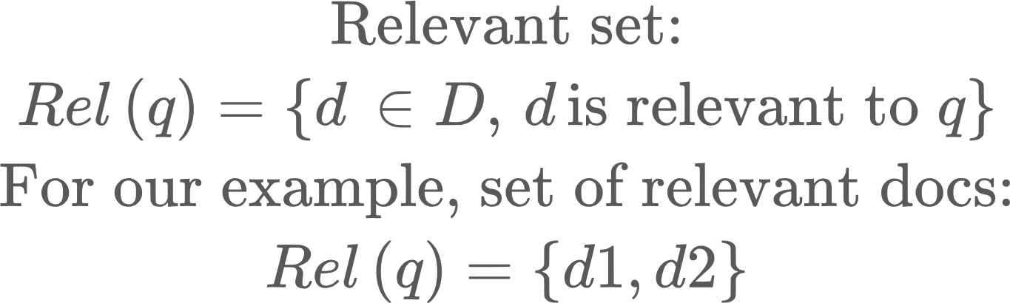
Relevance: Binary or Graded
Is a document relevant to a query, and how relevant is it?
A human annotator assigns a label to (query, document) pairs.
Binary: relevant or not
Graded: 0 (not relevant), 1 (somewhat relevant), 2 (highly relevant)..

Slide 8
Relevance Metrics
Unordered: We treat the result set as a bag of docs
Ordered: We care about the order of docs in the result set

Slide 9
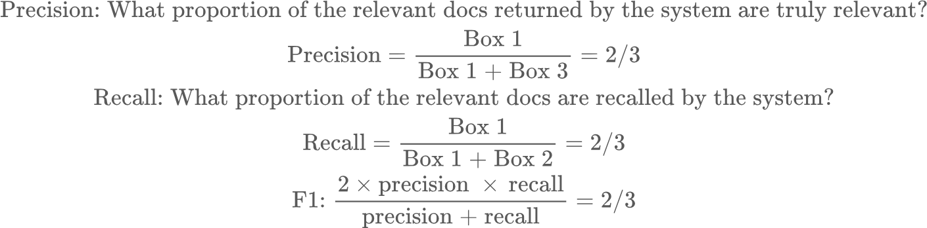
Unordered Relevance Metrics
q: "hikes near NYC"
d1: "Best hikes near NYC area" (highly relevant) d2: "Hiking safety tips and trail etiquette" (somewhat relevant) d3: “Popular hikes in the NY metropolitan area (highly relevant) d4: “Top 10 restaurants in New York city" (irrelevant) d5: “Neural networks and deep learning basics” (irrelevant) d6: “Rise and fall of the Roman empire” (irrelevant)
Precision/Recall
For our query, relevant docs (2): {d1, d2, d3}, irrelevant docs (2): {d3, d4}
System A returns relevant docs (2): {d1, d2, d4}, rest {d3, d5, d6} irrelevant.
Confusion Matrix:
 | R | NR
R | Box 1 {d1, d2} | Box 2 {d3}
NR | Box 3 {d4} | Box 4 {d5, d6}
Row: Actuals
Col: System

Slide 10
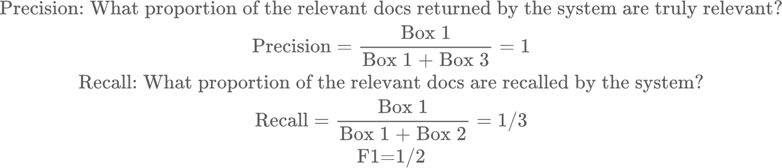
Unordered Relevance Metrics
System B is more conservative. It only returns relevant docs: {d1}, irrelevant docs: {d2, d3, d4, d5, d6}
 | R | NR
R | Box 1 {d1} | Box 2 {d2, d3}
NR | Box 3 | Box 4 {d4, d5, d6}
Takeaway:
We can make a system more precise by raising the bar of making a relevant determination, but that comes at the expense of recall. Alternatively, we can achieve a perfect recall by judging every document relevant, but that comes at the expense of precision
Precision/Recall trade-off varies by application. A mammogram scanning system must have high recall (we don’t want to miss any positive scans), a scam detection system must have high precision (we don’t want to mislabel a good message as spam and remove it from the inbox.. It is more acceptable to miss some spam messages and allow them in the inbox)

Slide 11
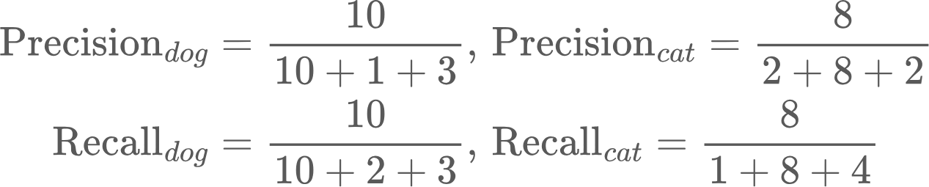
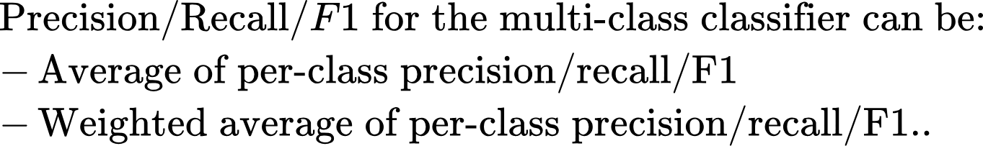
Classification problems
Precision/Recall apply directly to binary classification problems. It can also be extended to multi-class problems. For multi-class problems, we compute precision/recall/F1 for every class, as a binary class problem, coalescing all misclassifications for that class
Classifier said cat, but actually a dog
 | Dog | Cat | Mouse
Dog | 10 | 2 | 3
Cat | 1 | 8 | 4
Mouse | 3 | 2 | 12
Classifier said mouse, but actually a cat

Slide 12
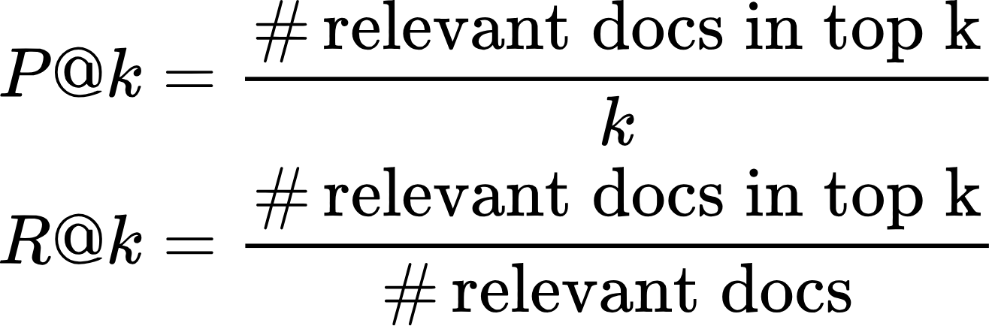
Rank-aware Relevance Metrics
An IR system could return ranked list, not just sets..
For a query q with relevant docs {d1, d2}, system returns ranking:
Rank 1: d3 (irrelevant)
Rank 2: d1 (relevant)
Rank 3: d4 (irrelevant)
Rank 4: d2 (relevant)
Then,
P@1: 0/1, R@1: 0/2
P@2: ½, R@2: ½
P@3: ⅓, R@3: ½
P@4: 2/4, R@4: 2/2

Slide 13
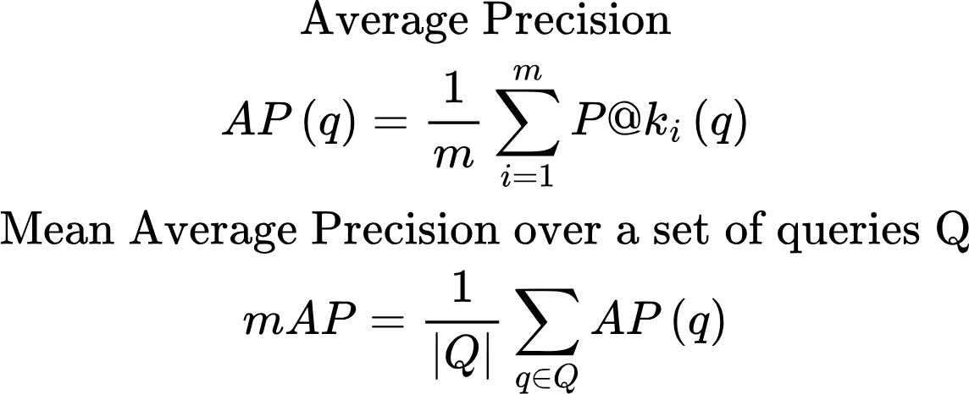
Average Precision and Mean Average Precision (mAP)
A single scalar metric that combines “how many relevant docs” and “how early they appear”
For a query q, with a ranked list of results, consider all ranks where a relevant document appears. Let these ranks be k_1, k_2,...,k_m (there are m relevant docs in the corpus for this query).

Slide 14
Examples AP, mAP
System 1: Query q with relevant docs {d1, d2}, and ranking
rank1: d1 (relevant) rank2: d3 (irrelevant) rank3: d4 (irrelevant) rank4: d2 (relevant)
P@1: 1/1 = 1 P@4: 2/4: 0.5
AP(q) = (1+0.5)/2 = 0.75
System 2: Query q with relevant docs {d1, d2}, and ranking
rank1: d4 (irrelevant) rank2: d3 (irrelevant) rank3: d1 (relevant) rank4: d2 (relevant)
P@3: 1/3 = 0.33 P@4: 2/4: 0.5
AP(q) = (0.33+0.5)/2 = 0.416

Slide 15
Mean Reciprocal Rank
Specially natural when there is one primary relevant document (eg., QA)
For a query q, Reciprocal Rank (q) = 1/position at which first relevant doc appears
Then MRR = RR averaged over all queries
Eg., for query q, relevant docs {d1, d3}
Ranking A: d1 appears at rank 1 -> RR = 1/1 = 1
Ranking B: d3 appears at rank 3 -> RR = ⅓ = 0.33

Slide 16
Homework
hw1.py: Calculate precision, recall, F1, precision/recall@k, MRR for a simple example

Slide 17
Appendix

Slide 18
Rank Fusion and Reranking
Rank fusion
Why combine multiple retrieval signals:
Lexical vs dense vs site-specific priors, etc.
Reciprocal Rank Fusion (RRF)
Formula; intuition: “reward early ranks across systems.”
Briefly mention:
CombSUM, CombMNZ – optional.
Reranking
Two-stage/multi-stage ranking
Stage 1: fast recall (BM25/dense/SPLADE).
Stage 2: expensive rerankers.
Cross-encoder rerankers
E.g., BERT-style model that takes (query, doc) and outputs relevance.
Much slower, but higher quality.
Learning to Rank (LTR) (if you want a more classical angle)
Pointwise, pairwise, listwise objectives.
Examples: RankNet, LambdaMART (high-level).
For LLM era:
LLM-based reranking (few-shot, instruction-tuned rerankers).

